Slide 1
Modeling ASHP in REopt
Case Studies
June 24, 2024
DRAFT – NOT FOR CITATION, QUOTATION, OR DISTRIBUTION

Slide 2
Key Questions Addressed by These Case Studies
What financial impacts could thermal electrification via electric heater or air-source heat pump (ASHP) systems have on the studied site?
What are the most cost-effective size of ASHPs to serve space heating/cooling load and domestic hot water at the studied site?
What are the required size of ASHPs to replace existing heating/cooling systems to serve space heating/cooling load and domestic hot water at the studied site?
What are the emissions impacts of replacing the system’s existing boiler with these ASHP systems?
DRAFT – NOT FOR CITATION, QUOTATION, OR DISTRIBUTION

Slide 3





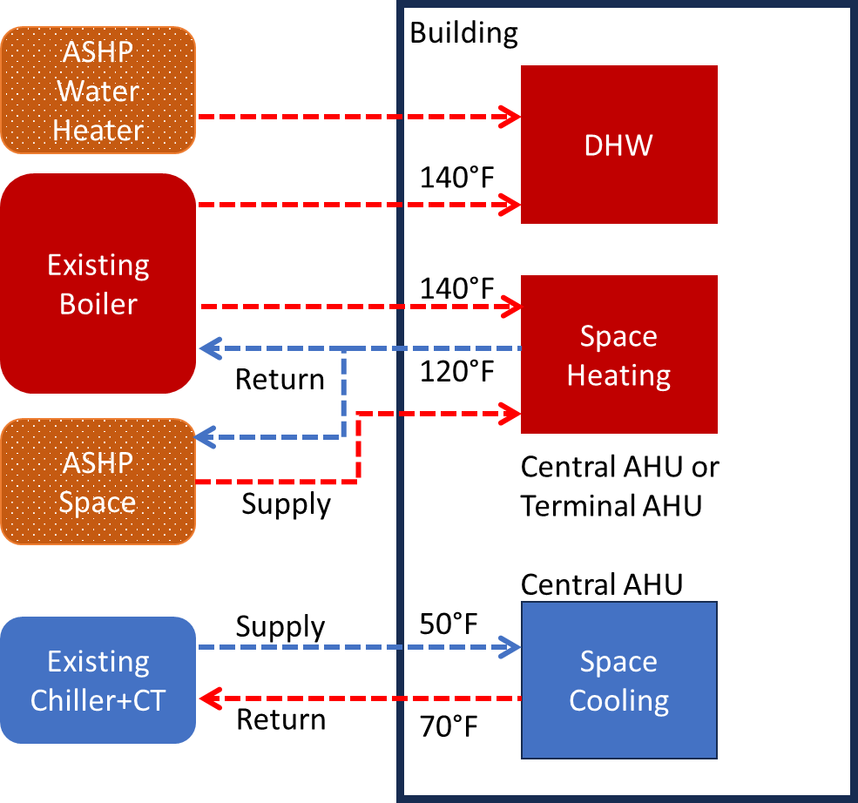
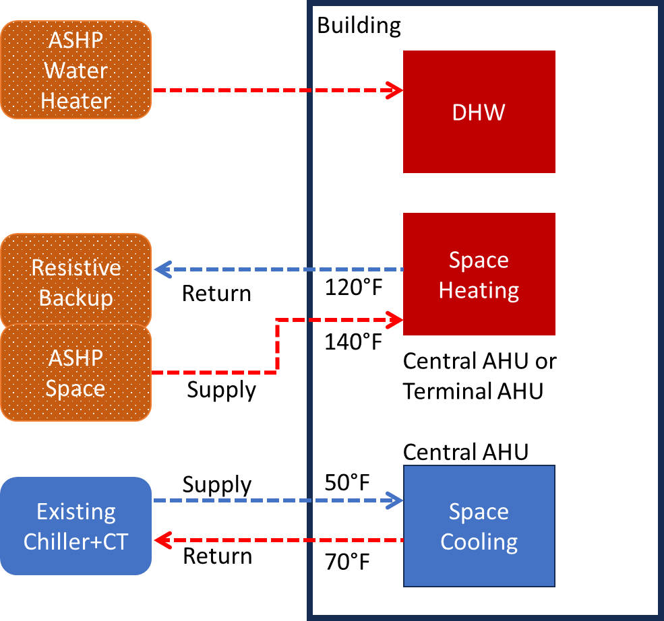
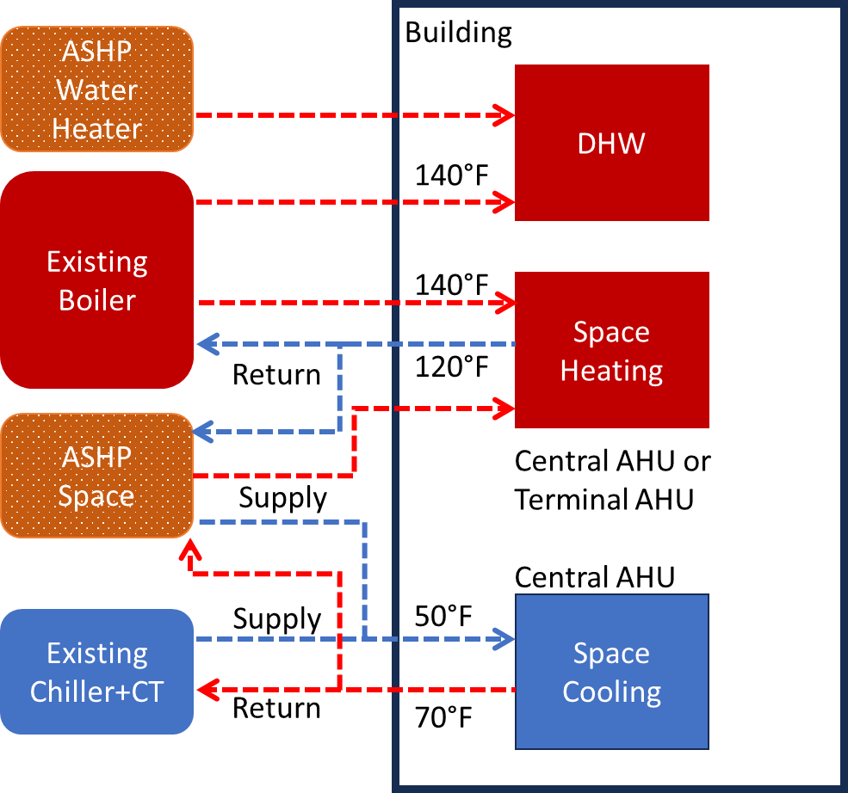
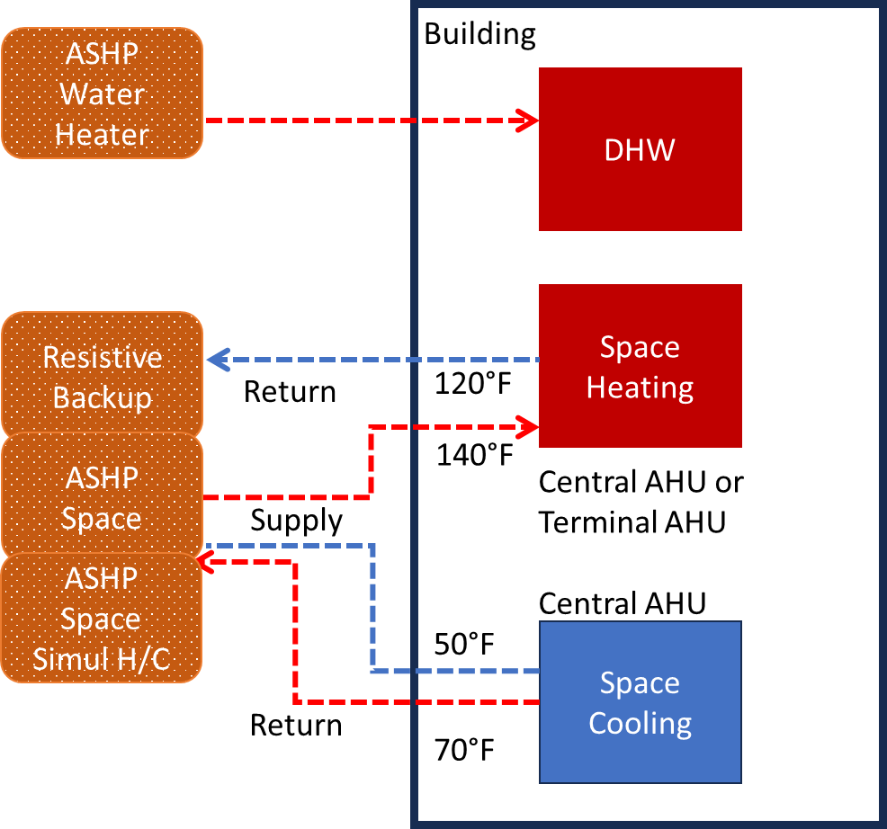
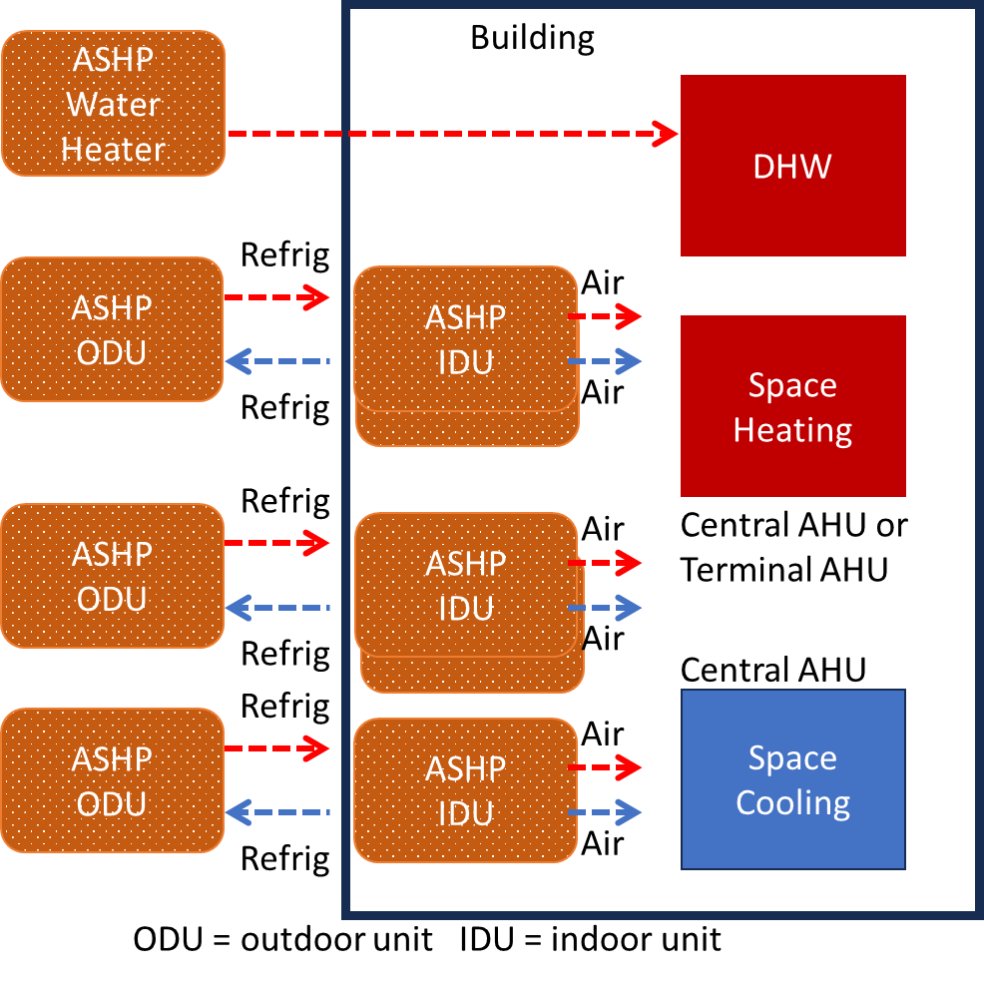
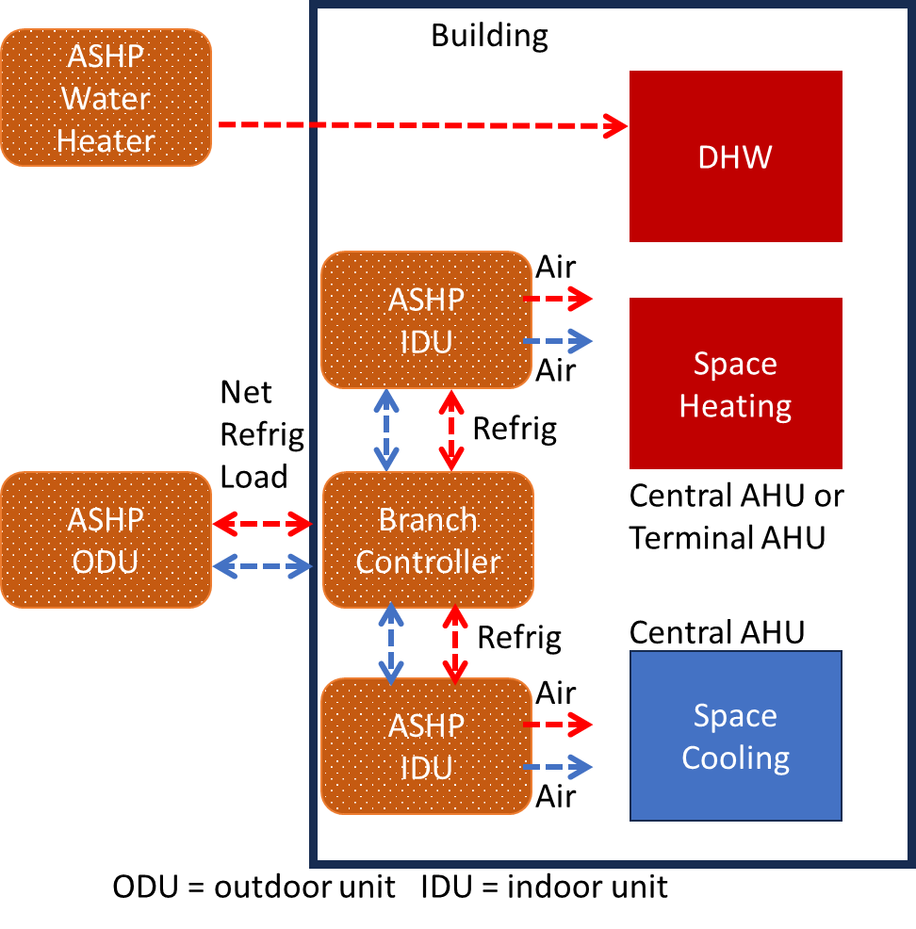
Case Studies Summary
Different building types
In cities in different climates
Cold Climate: Minneapolis, MN
Swing Climate: Chicago, IL
ASHP Sizes + Performance
Large Office
Large Hotel
Midrise Apartment
Hot Climate: Miami, FL
Other Climate: Los Angeles, CA
Energy Cost Savings
Retail Store
Secondary School
Emission Impacts
Six ASHP system configurations

Slide 4
Fuel Cost Assumptions
City | Heating Gas [$/MMBtu] | Source
Minneapolis, MN | $10.2 | https://www.bls.gov/regions/midwest/data/averageenergyprices_selectedareas_table.htm
Chicago, IL | $10.0
Miami, FL | $30.2
Los Angeles, CA | $15.6
DRAFT – NOT FOR CITATION, QUOTATION, OR DISTRIBUTION

Slide 5
ASHP System Configurations in REopt
Discuss the 6 configs here
DRAFT – NOT FOR CITATION, QUOTATION, OR DISTRIBUTION

Slide 6
Cold Climate City Case Study
Results for Minneapolis, MN

Slide 7
System Configuration 1
ASHP space heater and ASHP water heater can be deployed with existing boiler
Cooling load is supplied by existing chiller (ASHP does not provide cooling)
Building Type | ASHP-SH size [ton] | ASHP-WH size [ton] | LCC [$] | NPV [$] | LCCC [$] | ASHP-SH Prod [mmbtu] | ASHP-WH Prod [mmbtu] | Existing Boiler Prod [mmbtu] | Existing Chiller Prod [ton] | Electric Heater Prod [mmbtu] | CO2 Emission Saving [ton] | Avoided Health Damages [$]
Large Office | 0 | 1.1 | 9.12M | 0.96k | 2.44k | 0 | 0 | 8.29k | 634k | 0 | 103 | 1,643
Large Hotel | 2.1 | 34 | 4.79M | 48.3k | 81.14k | 148 | 148 | 8.26k | 594k | 0 | 3,983 | 61,583
Midrise Apartment | 0 | 1.8 | 0.57M | 1.79k | 3.96k | 0 | 0 | 1.59k | 28k | 0 | 173 | 2,863
Retail Store | 0 | 0 | 0.87M | 0k | 0k | 0 | 0 | 1.50k | 36k | 0 | 0 | 0
Secondary School | 0 | 1.5 | 4.60M | 0.48k | 3.36 | 0 | 0 | 9.88k | 350k | 0 | 116 | 1,873
The cost-optimal solution deploys no or very small sized ASHP Space Heater
Most of heating load is provided by existing boiler

Slide 8
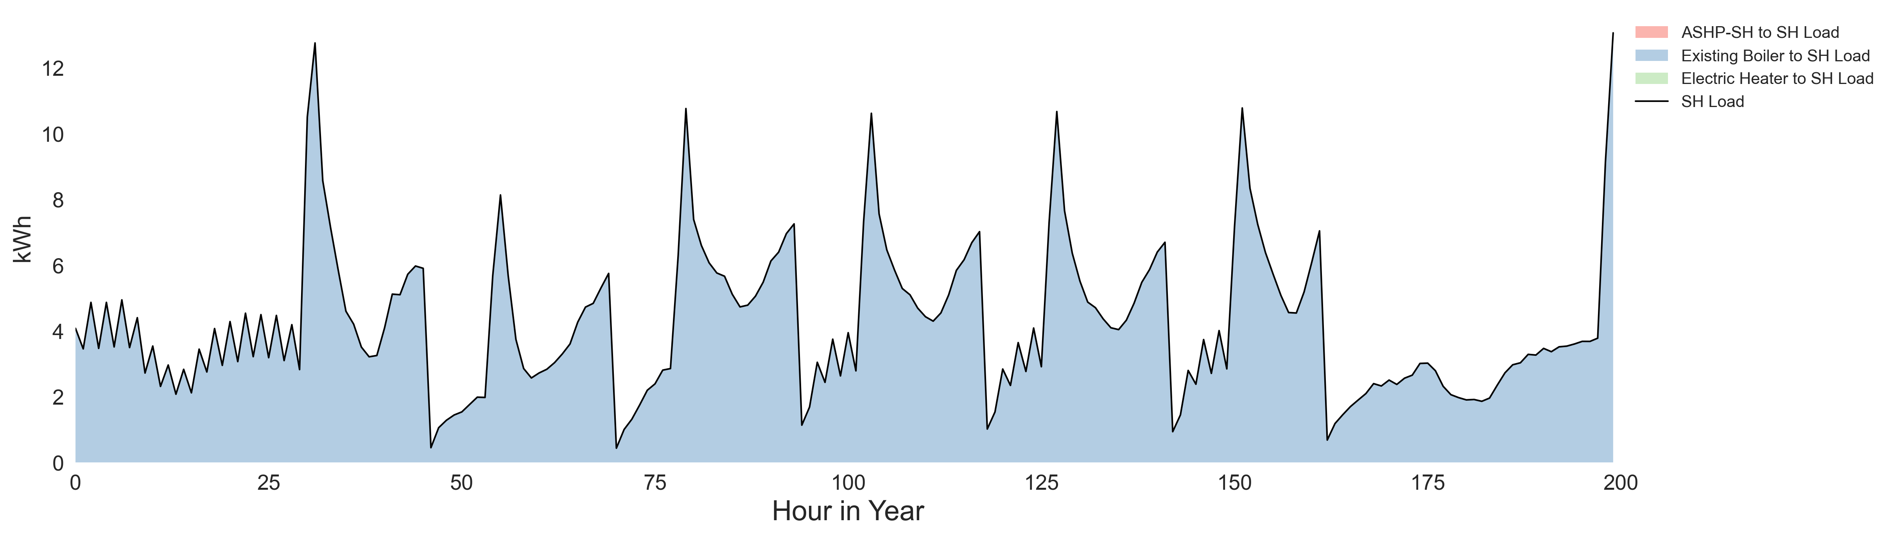
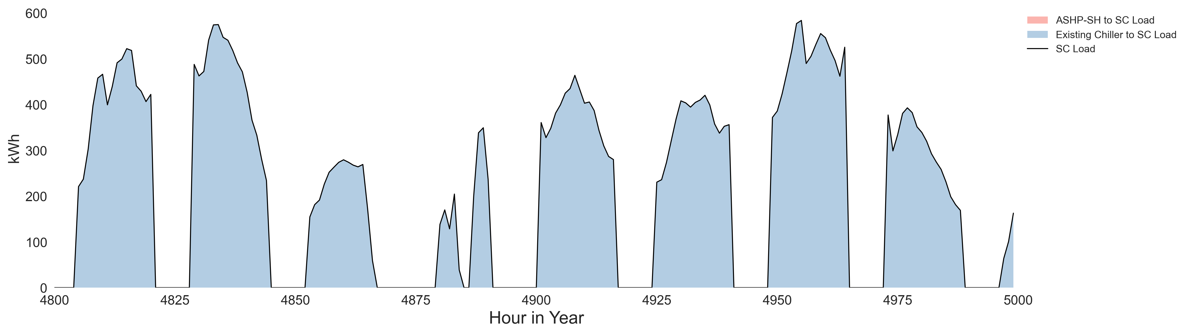
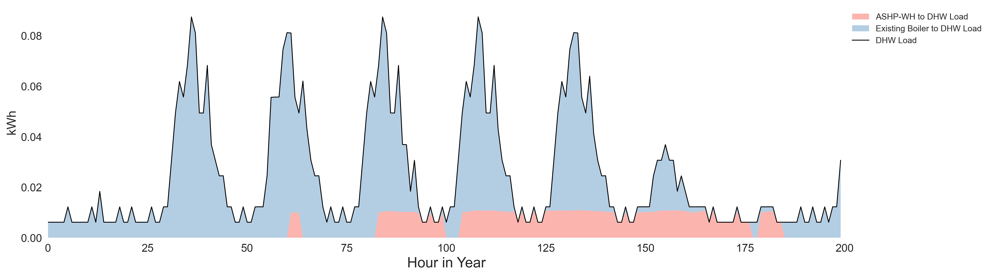
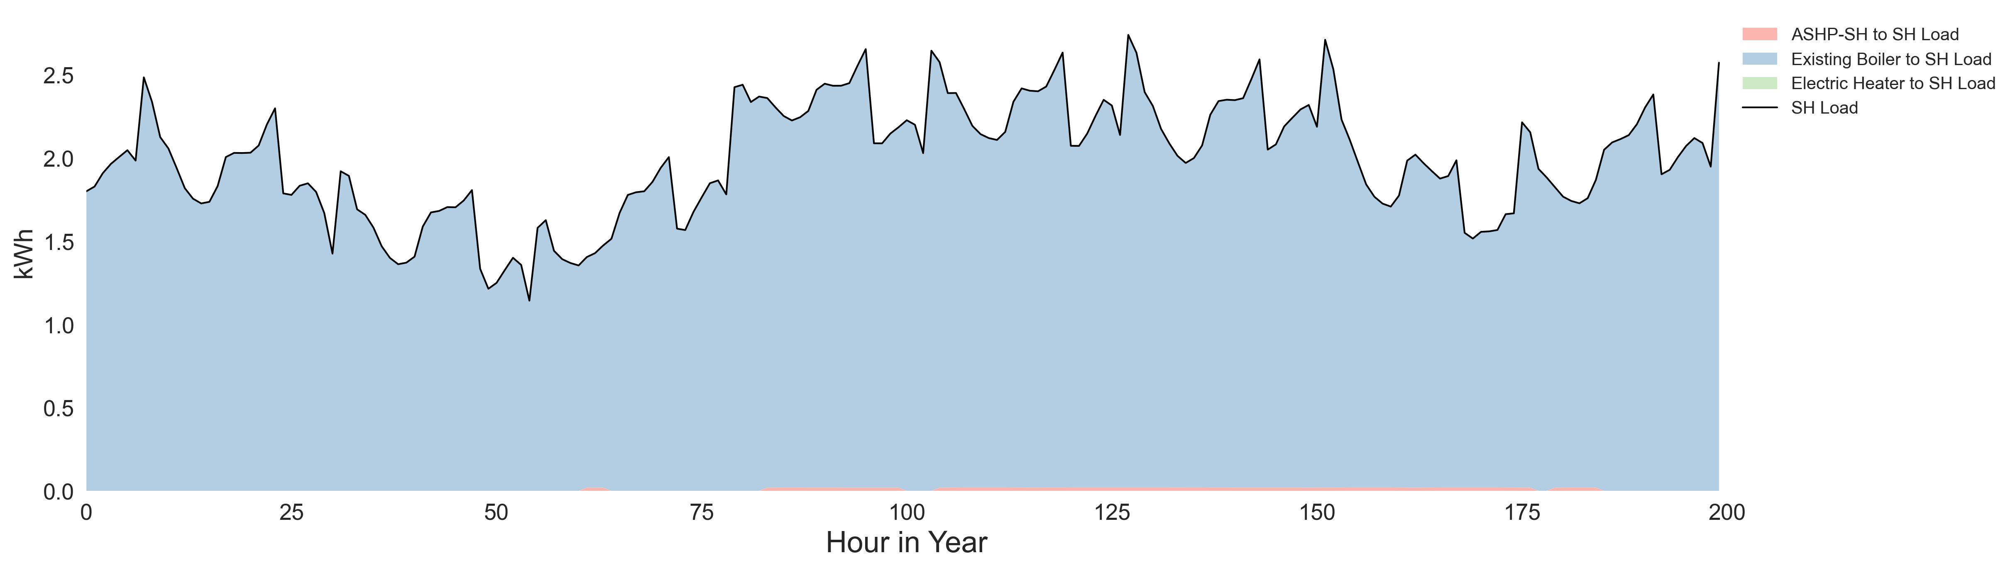
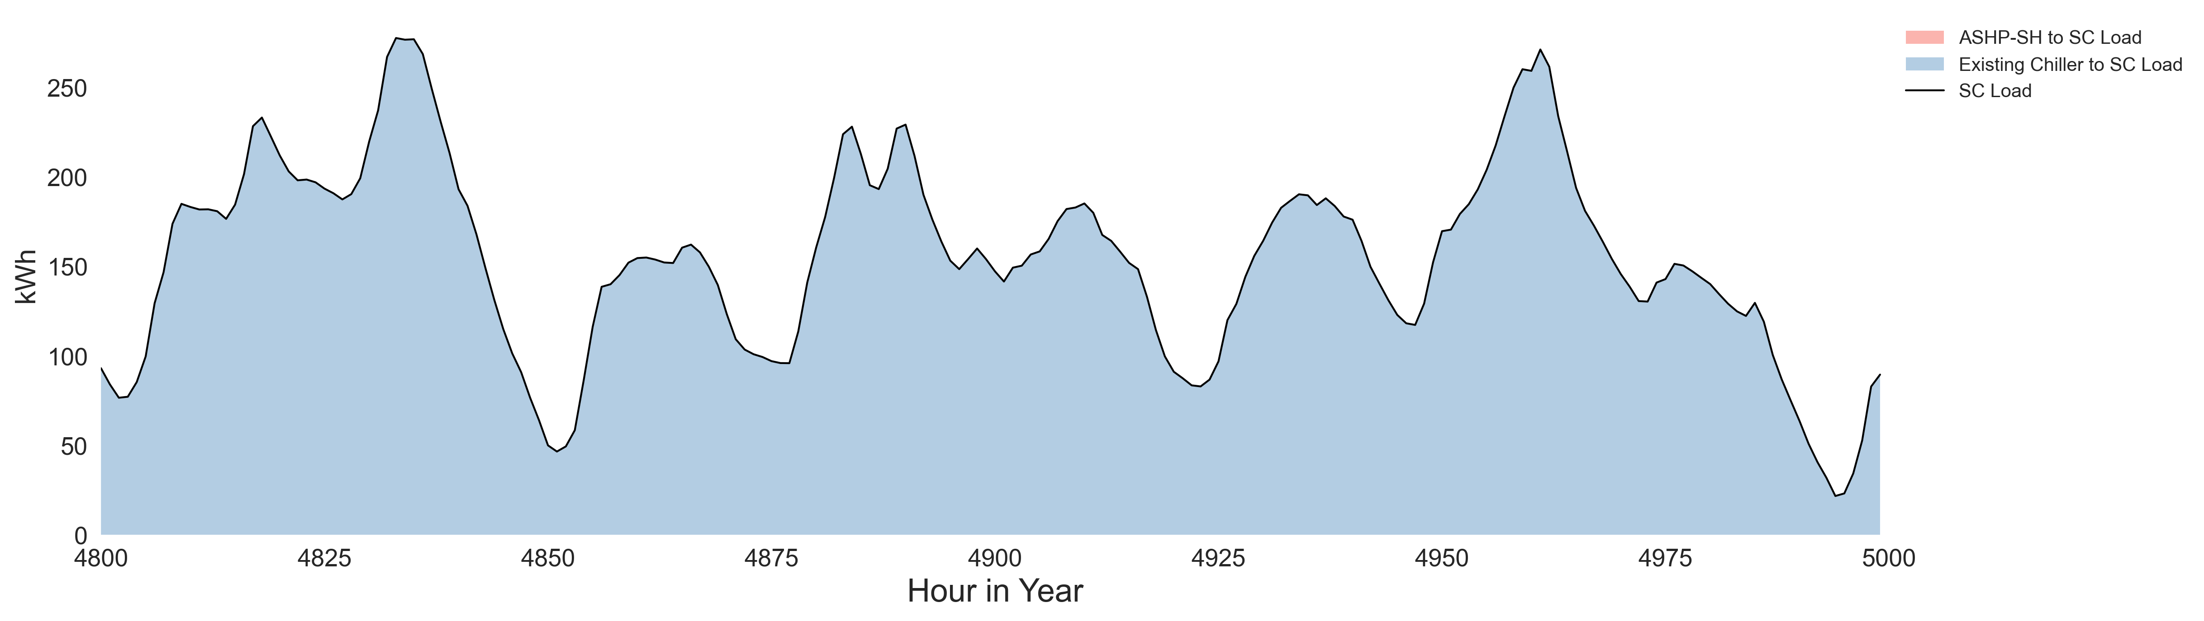
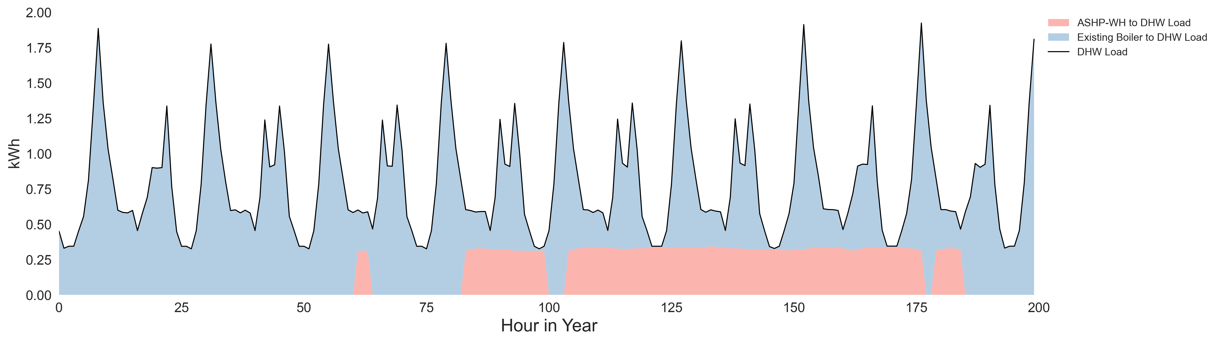
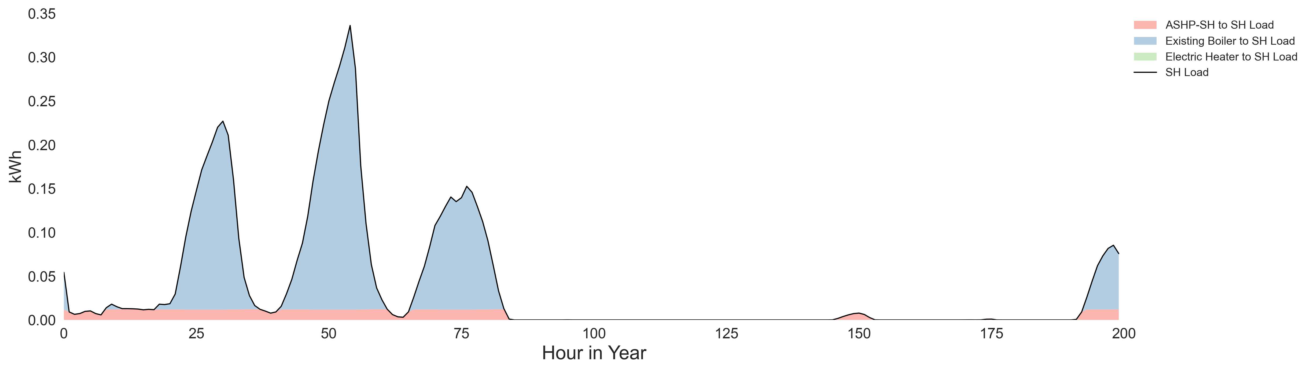
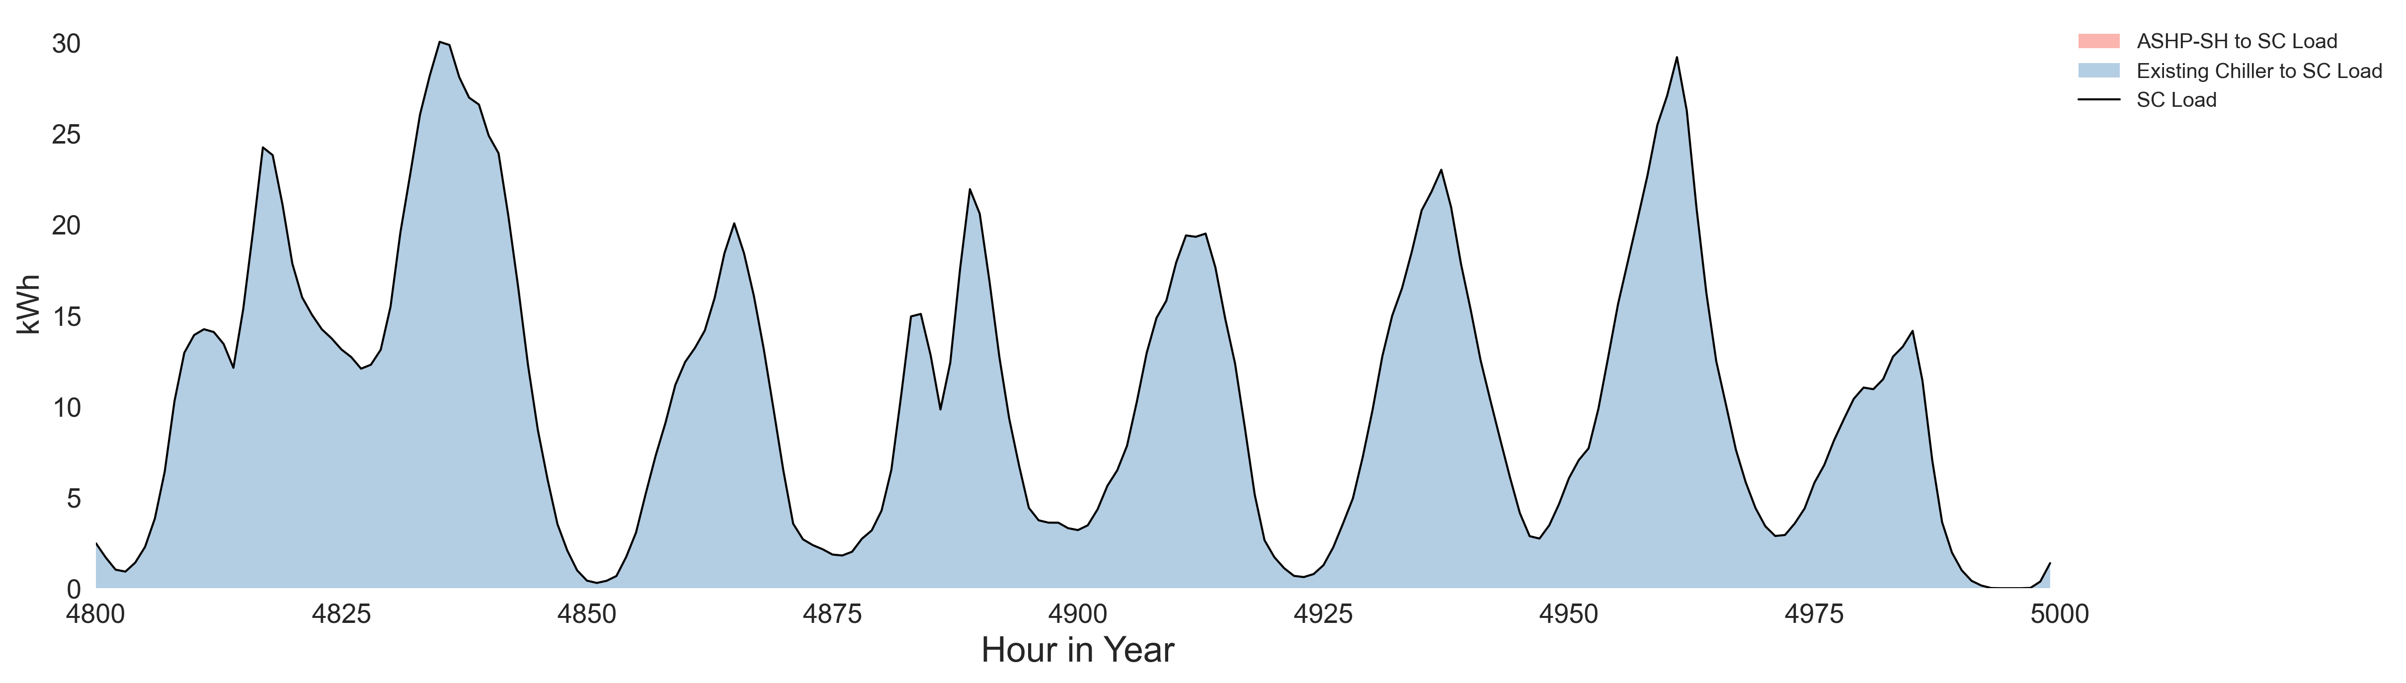
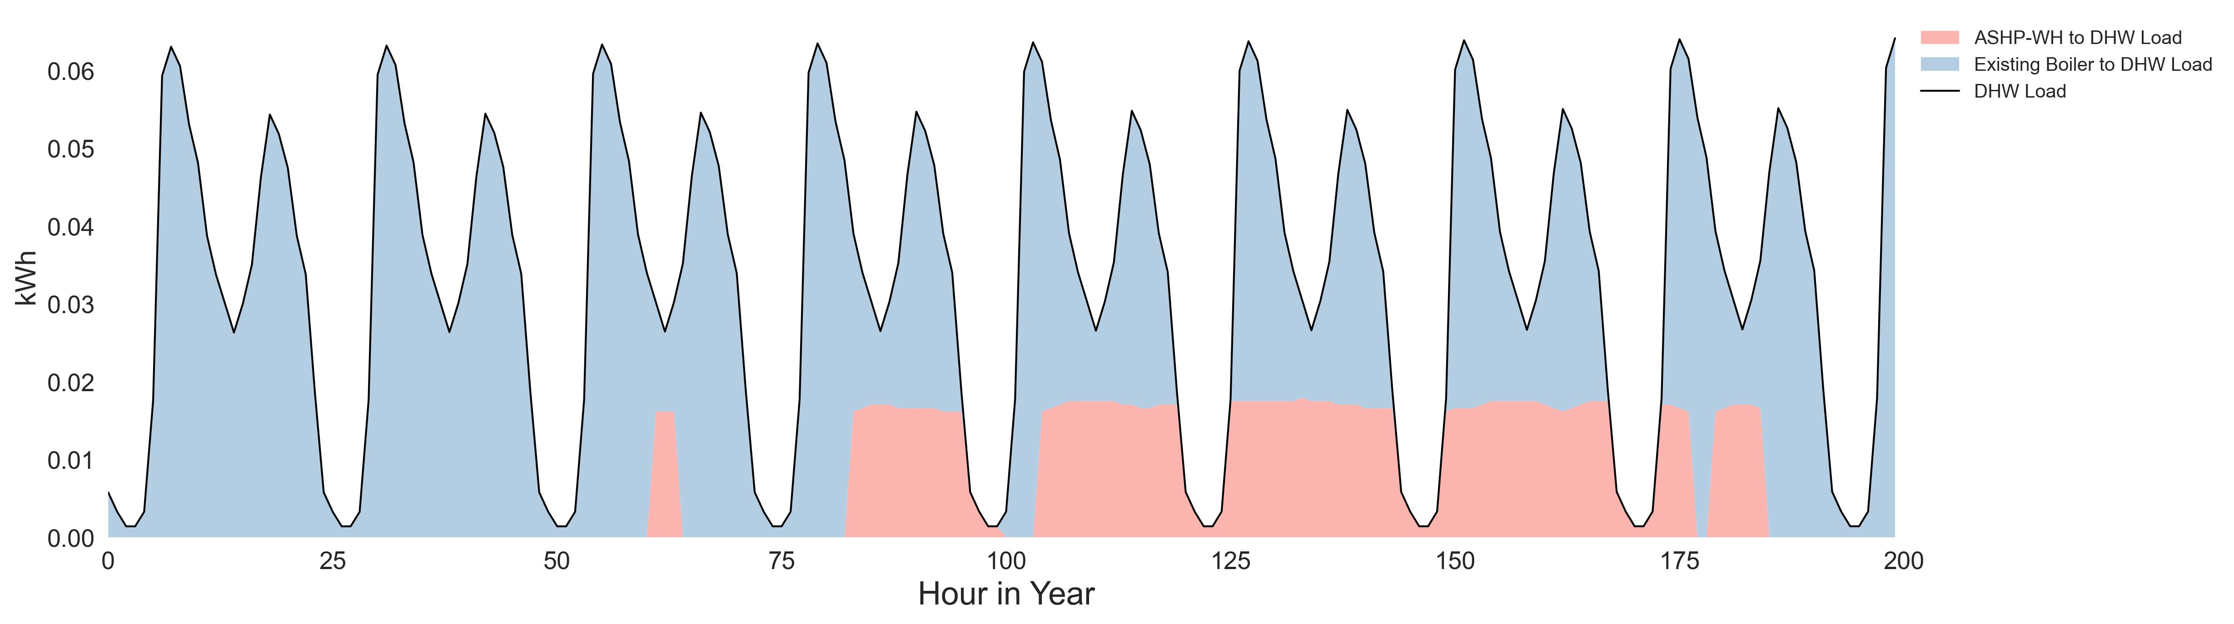
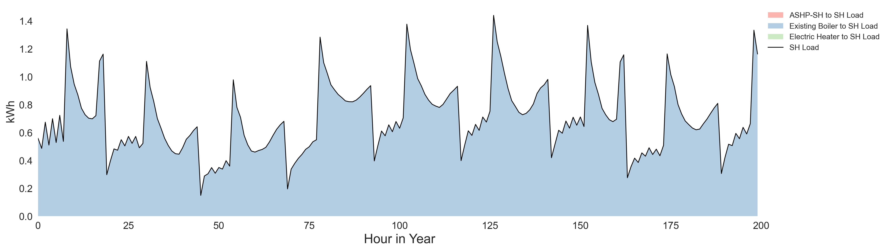
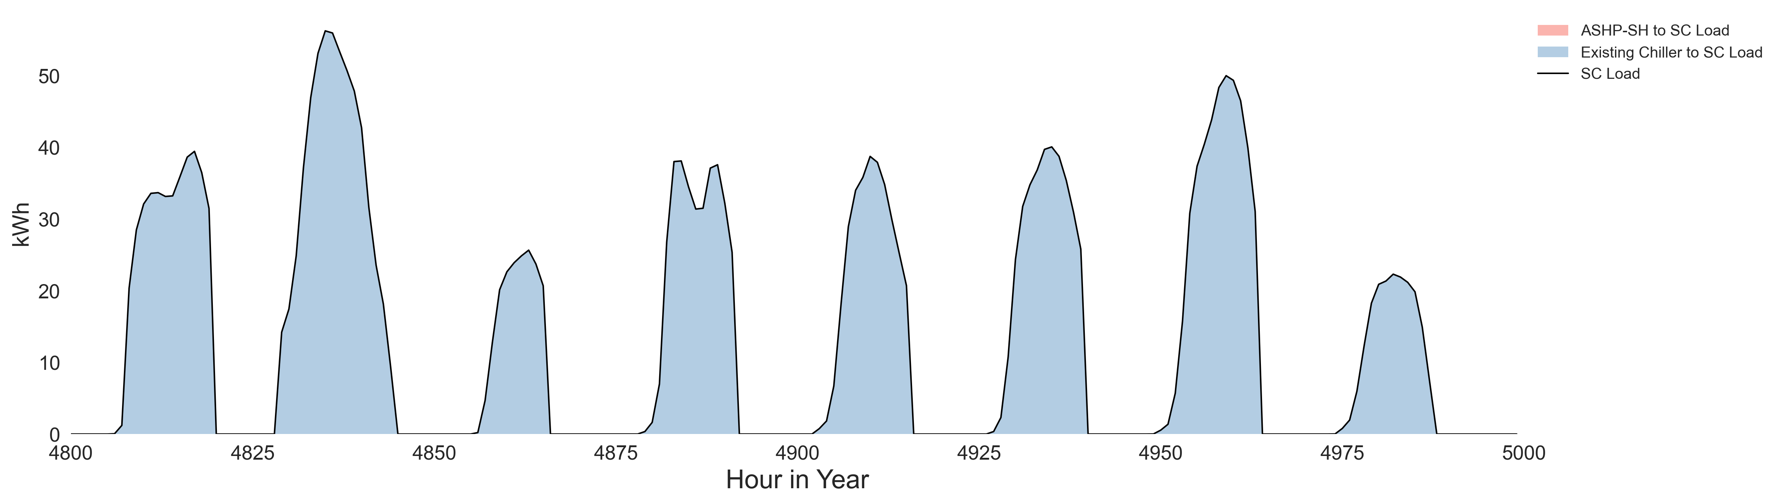
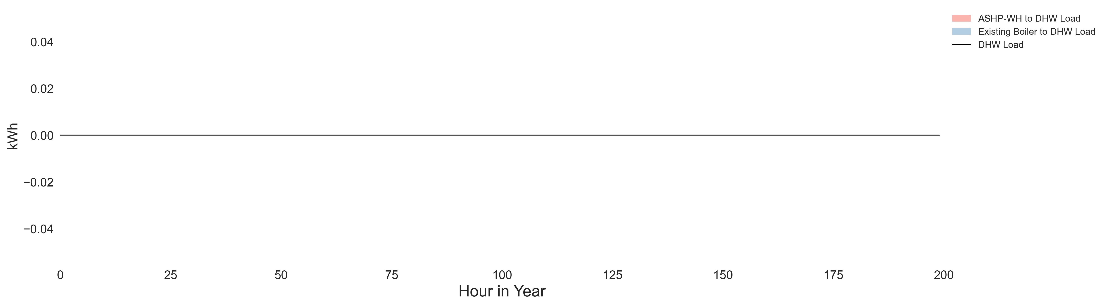
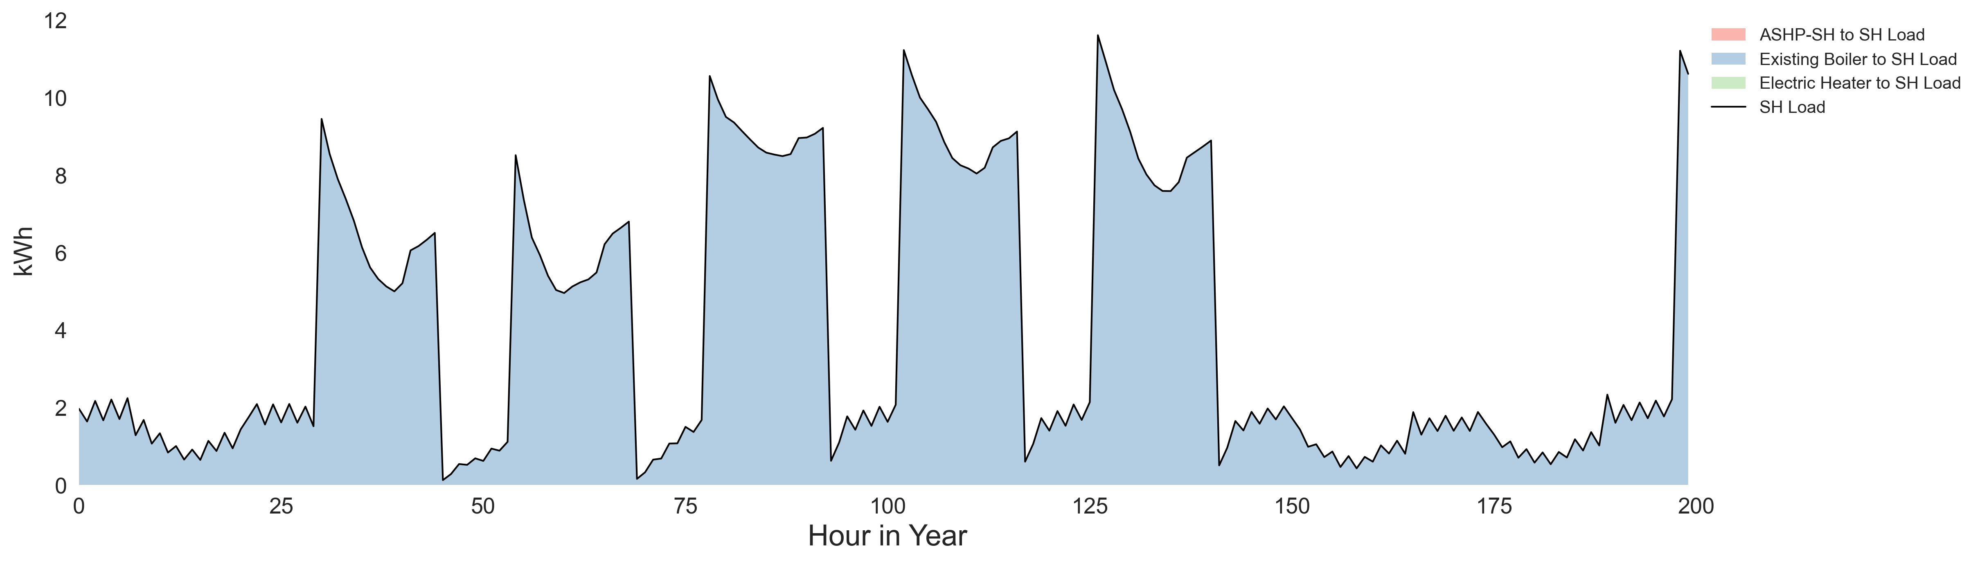
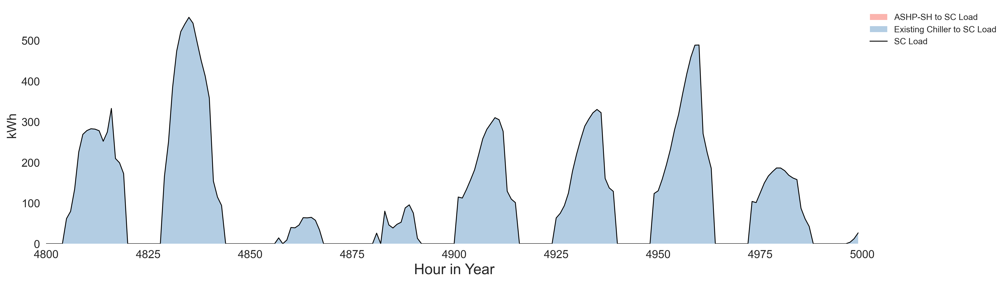
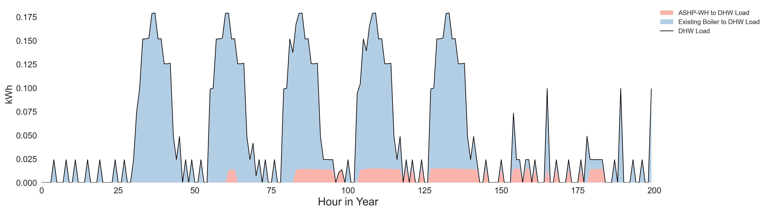
System Configuration 1
Space Heating
Space Cooling
DHW
Large Office
Large Hotel
Midrise Apartment
Retail Store
Secondary School

Slide 9
System Configuration 2
ASHP space heater and ASHP water heater forced to be deployed with resistive backup
Cooling load is supplied by existing chiller (ASHP does not provide cooling)
Building Type | ASHP-SH size [ton] | ASHP-WH size [ton] | LCC [$] | NPV [$] | LCCC [$] | ASHP-SH Prod [mmbtu] | ASHP-WH Prod [mmbtu] | Existing Boiler Prod [mmbtu] | Existing Chiller Prod [ton] | Electric Heater Prod [mmbtu] | CO2 Emission Saving [ton] | Avoided Health Damages [$]
Large Office | 0
Large Hotel | 2.1
Midrise Apartment | 0
Retail Store | 0
Secondary School | 0
The cost-optimal solution deploys no or very small sized ASHP Space Heater
Most of heating load is provided by existing boiler

Slide 10
System Configuration 2
Space Heating
Space Cooling
DHW
Large Office
Large Hotel
Midrise Apartment
Retail Store
Secondary School

Slide 11
System Configuration 3
ASHP space heater can be deployed to serve both heating and cooling load
DHW load can be supplied by both ASHP water heater and existing boiler
Building Type | ASHP-SH size [ton] | ASHP-WH size [ton] | LCC [$] | NPV [$] | LCCC [$] | ASHP-SH Prod [mmbtu/ton] | ASHP-WH Prod [mmbtu] | Existing Boiler Prod [mmbtu] | Existing Chiller Prod [kton] | Electric Heater Prod [mmbtu] | CO2 Emission Saving [ton] | Avoided Health Damages [$]
Large Office | 31.0 | 1.1 | 9.12M | 6.48k | 72.11k | 0.7k/ 66k | 699 | 7.6k | 568 | 0 | 1,151 | 42,134
Large Hotel | 79.4 | 34.0 | 4.84M | 235.1k | 255.2k | 1.7k/ 367k | 1,717 | 6.7k | 229 | 0 | 6,997 | 273,089
Midrise Apartment | 3.5 | 1.8 | 0.57M | 4.41k | 11.77k | 0.1k/ 6.9k | 135 | 1.5k | 21 | 0 | 371 | 7,975
Retail Store | 0 | 0 | 0.87M | 0 | 0 | 0 | 0 | 1.5k | 36 | 0 | 0 | 0
Secondary School | 0.3 | 1.5 | 4.60M | 0.5k | 4.0k | 6.4/ 484 | 6.4 | 9.9k | 349 | 0 | 125 | 2,186
When ASHP is used for both heating and cooling, it is mostly used for cooling

Slide 12
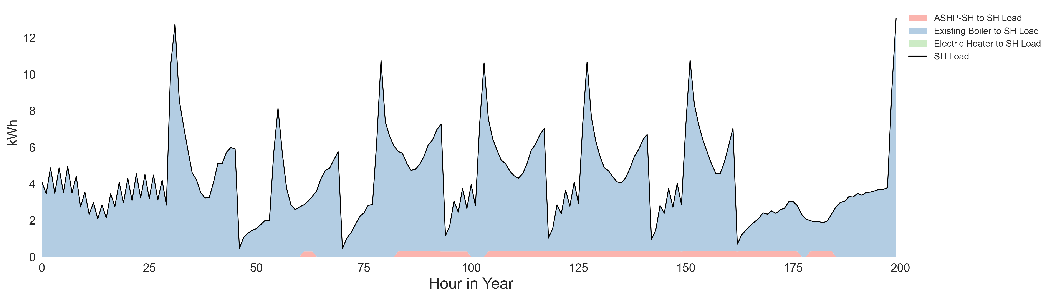
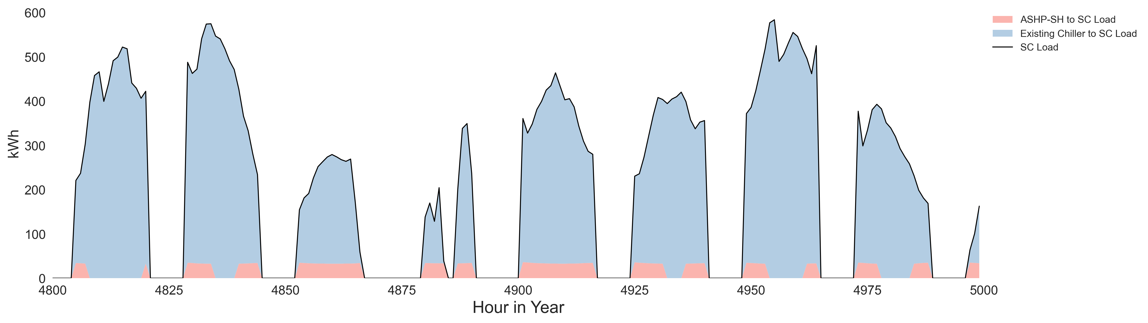
System Configuration 3
Space Heating
Space Cooling
DHW
Large Office
Large Hotel
Midrise Apartment
Retail Store
Secondary School

Slide 13
System Configuration 4
ASHP space heater is forced to be deployed to serve both heating and cooling load with resistive backup for heating
DHW load can be supplied by ASHP water heater only
Building Type | ASHP-SH size [ton] | ASHP-WH size [ton] | LCC [$] | NPV [$] | LCCC [$] | ASHP-SH Prod [mmbtu] | ASHP-WH Prod [mmbtu] | Existing Boiler Prod [mmbtu] | Existing Chiller Prod [ton] | Electric Heater Prod [mmbtu] | CO2 Emission Saving [ton] | Avoided Health Damages [$]
The cost-optimal solution deploys no or very small sized ASHP Space Heater
Most of heating load is provided by existing boiler

Slide 14
System Configuration 4
Space Heating
Space Cooling
DHW
Large Office
Large Hotel
Midrise Apartment
Retail Store
Secondary School

Slide 15
Key Takeaways

Slide 16
Appendix: REopt Model & Additional Modeling Assumptions

Slide 17


REopt Energy Planning Platform
Formulated as a mixed integer linear program, REopt provides an integrated, cost-optimal energy solution.
Drivers
Goals Minimize Cost
Clean Energy
Resilience
Economics
Technology Costs
Incentives
Financial Parameters
Energy Costs & Revenue
Energy & Demand Charges
Market Participation
Escalation Rates
Resources
Renewable Generation
Solar PV
Wind
Technologies
Technology Mix
Technology Size
Conventional Supply
Electric Grid & Fuel Supply
Conventional Generators
Combined Heat and Power
Energy Planning Platform
Techno-Economic Optimization
Operations
Optimal Dispatch
Optimized Minimum
Cost Solution
Technology Options
Energy Storage
Batteries
Thermal storage
Project Economics
Capital Costs
Operating Costs
Net Present Value
Geothermal Heat Pumps
Progress Toward Goals
Emissions Reduction
Length of Outage Sustained
Thermal Loads
DRAFT – NOT FOR CITATION, QUOTATION, OR DISTRIBUTION
Electric Loads

Slide 18
REopt Minimizes the System’s Lifecycle Cost of Energy
Life cycle cost (LCC) of energy: The present value of all energy costs at the studied site throughout the analysis period (25 years).
Net present value (NPV): The lifecycle cost savings (difference in LCC) between the business-as-usual (BAU) case and the investment case.
If NPV > 0, the new system yields savings to BAU
If NPV < 0, the new system is more expensive than BAU
Economic Incentives (if Available)
Cost of Purchasing Electricity from Utility
Operational Costs
LCC of Energy System
Capital Cost of New Investment
LCC of New Energy System
LCC of BAU
NPV
DRAFT – NOT FOR CITATION, QUOTATION, OR DISTRIBUTION

Slide 19




How Can You Use REopt?
Easy-to-use, free web tool
reopt.nrel.gov
Application Programming Interface (API)
https://github.com/nrel/reopt-api-analysis/wiki
Open-source codebase
https://github.com/NREL/REopt_API and https://github.com/NREL/REopt.jl
Custom NREL analysis

